Slide 1
Parameterized post-Friedmann framework for interacting dark energy
Xin Zhang
Northeastern University

Slide 2
Contents
Why IDE?
How to consider IDE?
How to detect the coupling?
How to calculate perturbation evolution of IDE?
Early-time large-scale instability problem
Solution: PPF for IDE
Exploration of whole parameter space
Tests of IΛCDM

Slide 3
Why IDE?
A better question: Why not consider IDE? ----- Actually, no interaction between DE and DM is a specific assumption.
Some advantages in theoretical aspect, e.g., alleviating the coincidence problem. But this is secondary.
More important issue: How to detect this “fifth force”, or falsify it.
Current data favor a 6-parameter base ΛCDM model. But this model must need extension. From the perspective of DE, the simplest one-parameter extension: (1) wCDM (2) IΛCDM.

Slide 4

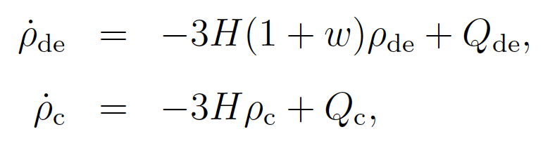




How to consider IDE?
Lack micro-physical mechanism, so can only consider it from phenomenological perspective.
Usual: Assume a form for the energy density transfer rate Q. In a perturbed universe, there is also a momentum density transfer rate.
Calculate cosmological consequences!

Slide 5
How to detect the coupling?
Impossible to directly detect such a “fifth force”, can only indirectly detect it (global fit).
Calculate how it affects cosmological evolution (expansion history and growth of structure).
This requires us to study cosmological perturbations. DE is not a pure background, so it also has perturbations. How to consider the perturbations of DE?---Important for understanding the nature of DE.

Slide 6
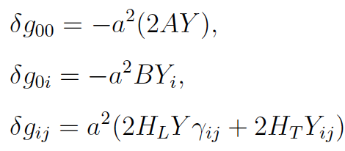
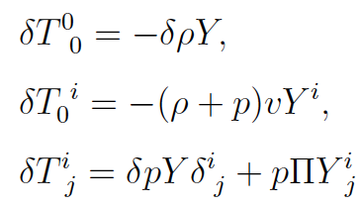



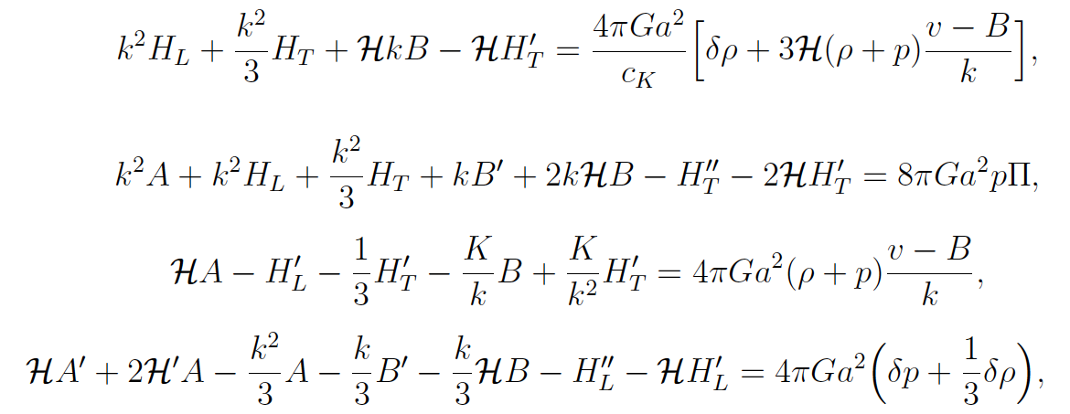

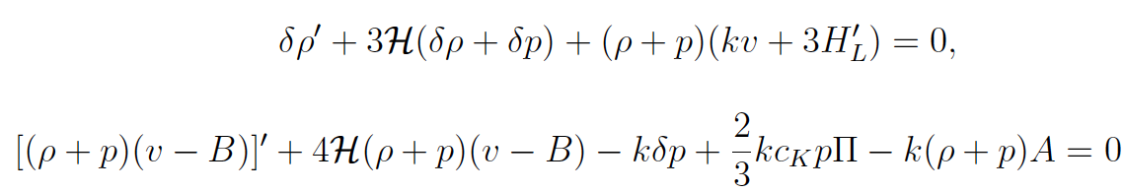
Calculate the perturbation evolutions
metric
energy-momentum tensor
Einstein eqs
continuity and Navier-Stokes eqs

Slide 7

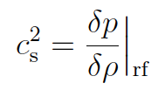

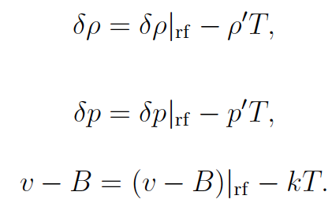
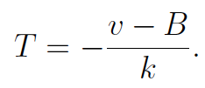

3 variables (δρ, v, δp), 2 equations.
Needs an additional equation to relate pressure and density perturbations to complete the eqs system. That is an equation for sound speed.
For DE, adiabatic sound speed is not physical (c_{a}²<0).
One has to impose by hand a physical sound speed for DE, and view DE as a nonadiabatic fluid.

Slide 8
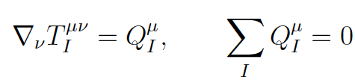



Interacting dark energy model
a covariant model:

Slide 9

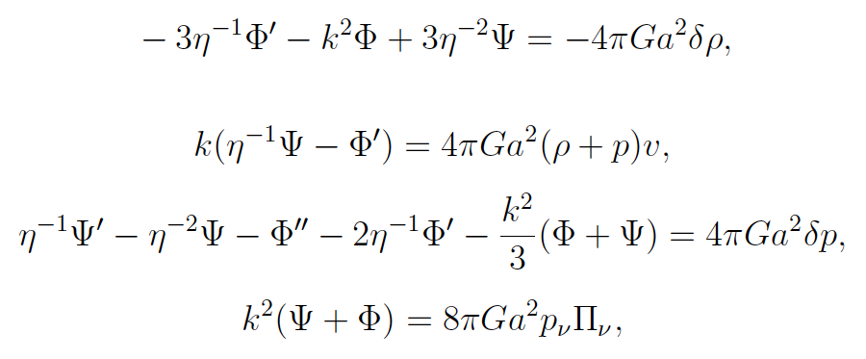

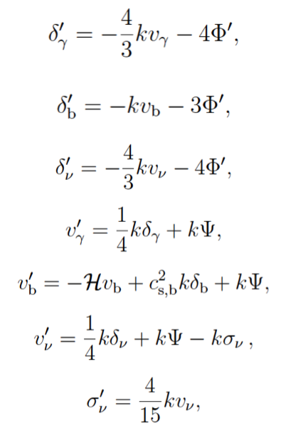
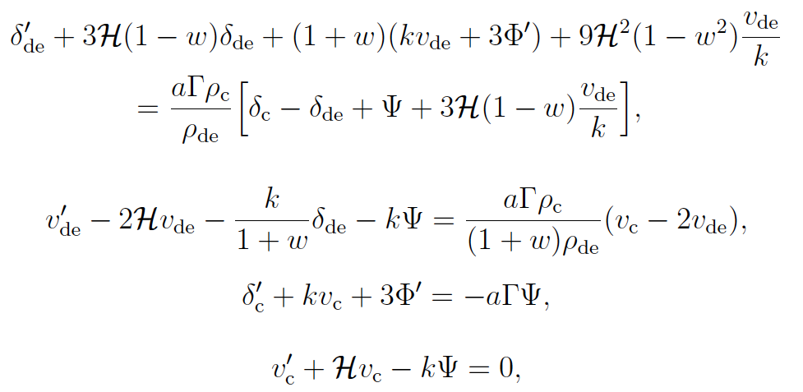

A concrete example
Newtonian gauge
early times:
Einstein eqs:
photon, baryon, neutrino
DE & DM

Slide 10
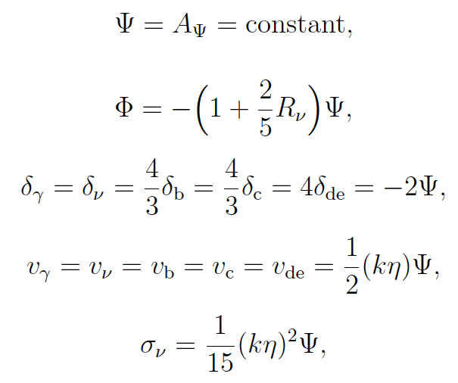

adiabatic initial conditions:

Slide 11
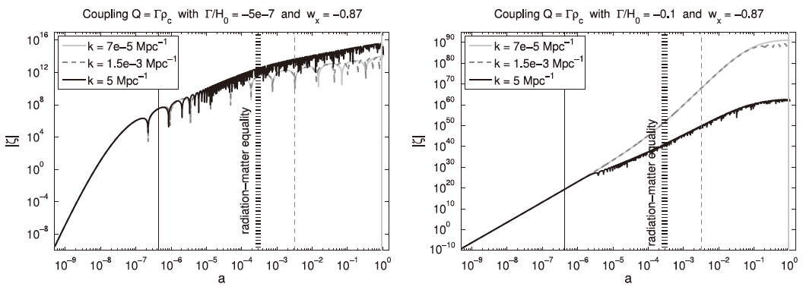
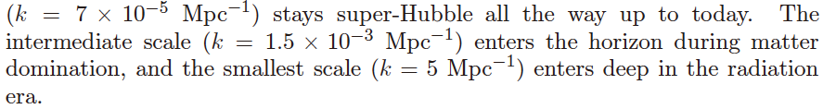
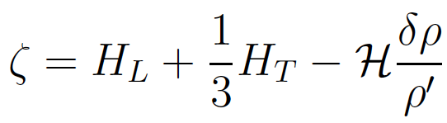
Early-time large-scale instability
Once calculate perturbations: For most cases, the curvature perturbation is divergent at early times (superhorizon).
Instability: w>-1

Slide 12
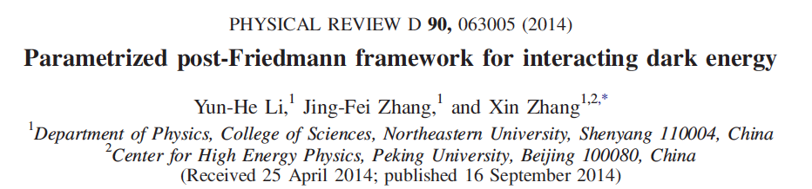
The pressure perturbation defined by sound speed involves nonadiabatic mode.
The nonadiabatic mode in uncoupled DE models will decay away, but in IDE models sometimes will rapidly grow, leading to blowup of curvature perturbation.
This reveals our ignorance about nature of DE. We actually do not know how to treat the perturbation of DE.
Way out: establish an effective theory based on the basic facts of DE---PPF. This generalizes the PPF of uncoupled DE of Fang, Hu & Lewis (2008).
arXiv:1404.5220

Slide 13
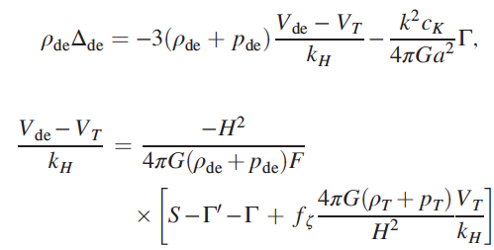

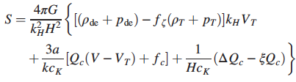



PPF for IDE

Slide 14
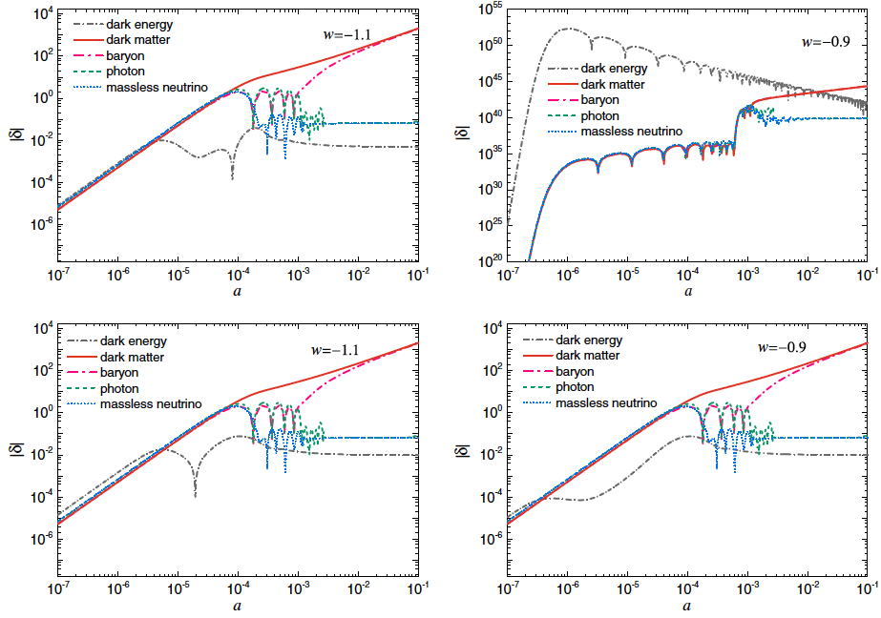
β > 0: DM → DE
β < 0: DE → DM
Example: k = 0.1 Mpc⁻¹ and β = -10⁻¹⁷

Slide 15
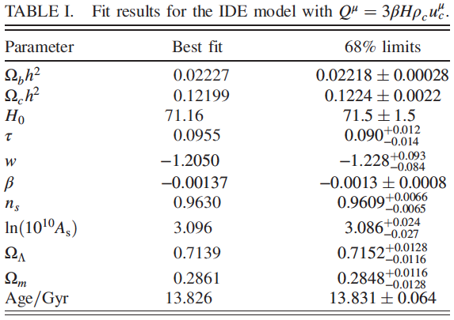
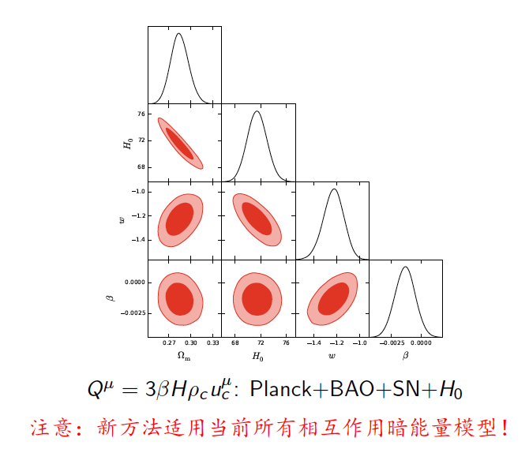
Whole parameter space can be explored
Prefer β < 0: DE → DM (1.6σ)
β = O(10⁻³), precision 60%
CMB itself can constrain β well
RSD do not improve significantly

Slide 16
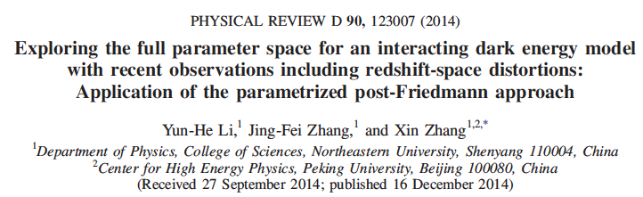
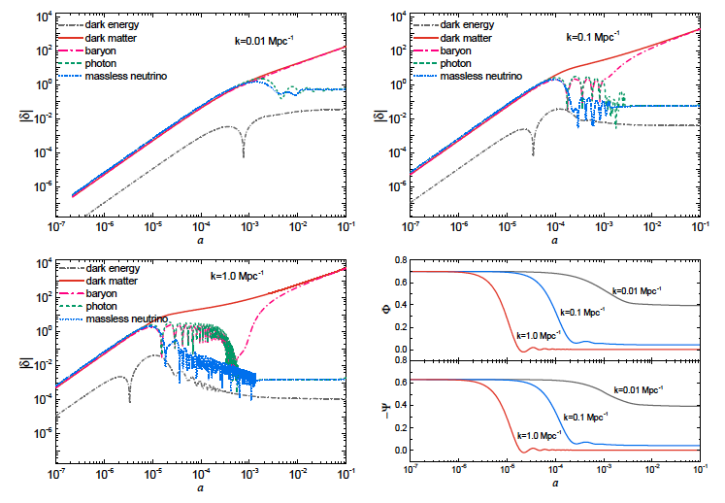

arXiv:1409.7205

Slide 17
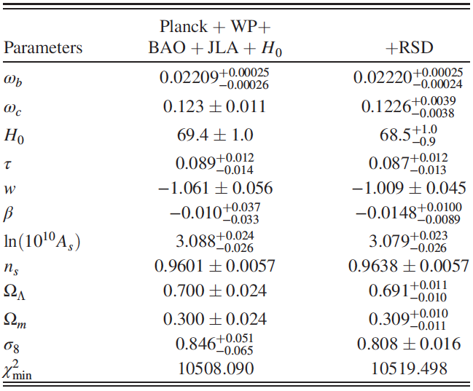
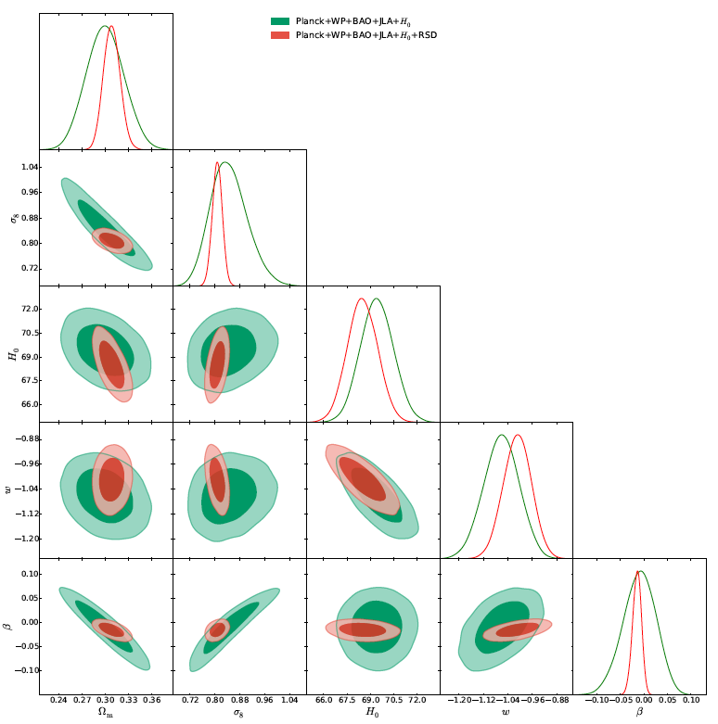
Previous works assume w>-1 and β>0, so the fit result is positive β～O(10⁻³), which is wrong!
RSD break degeneracy and improve fit significantly
RSD favor β<0 at 1.5σ, β～O(10⁻²)
w is around -1: IΛCDM model

Slide 18
Summary
6-parameter ΛCDM is currently favored by data, but extensions will be needed when facing future highly accurate data.
Some “fifth force” might exist between DE and DM, which should be tested.
To know how to consider DE perturbations is important for understanding the nature of DE.
Instability in IDE reveals our ignorance about the nature of DE. We actually do not know how to treat the perturbation of DE.
We thus establish a PPF framework for IDE.
Whole parameter space of IDE can be explored based on PPF.
Various models can be constrained by data. Testing IΛCDM: towards ΛCDM.
Future high-precision data are important: a long way ahead.

